Slide 1
ASM Refresher Training
Slide Deck

Slide 2
Welcome to ASM
New features and navigation
Enhanced automation of tasks

Slide 3
Agenda
Overview of ASM Video
What’s New
ASM Workbench
Create Your Program in the Workbench
Add/Update surveys on SIPR
We’ll use PPP as our example
Break between add and update
Add surveys using NIPR to SIPR Process
We’ll use SCRM as our example
Break
Assessment Overview
Run Analysis and Reports
Resources and Training Materials
These processes are the same and can be used interchangeably

Slide 4
Learning Objectives
Understand the role of ASM
Navigate the ASM Workbench
Add a Program Protection Plan (PPP) and Supply Chain Risk Management (SCRM) survey
Add/Update PPP and/or SCRM (and other surveys)
Use the NIPR to SIPR Process
Understand additional features such as assessments
Reports and Analysis - Run ASM Dashboard Report

Slide 5
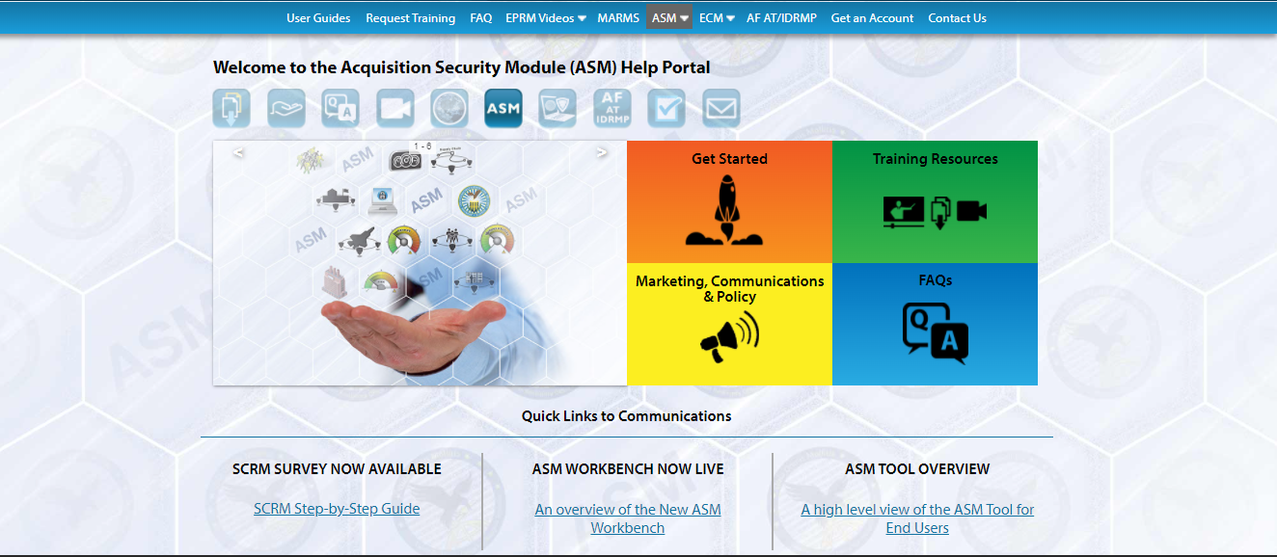
Training Resources
TRAINING RESOURCES RELATIVE TO TODAY CAN BE FOUND ON ASM HELP PORTAL
eprmhelp.countermeasures.com/asm.html

Slide 6

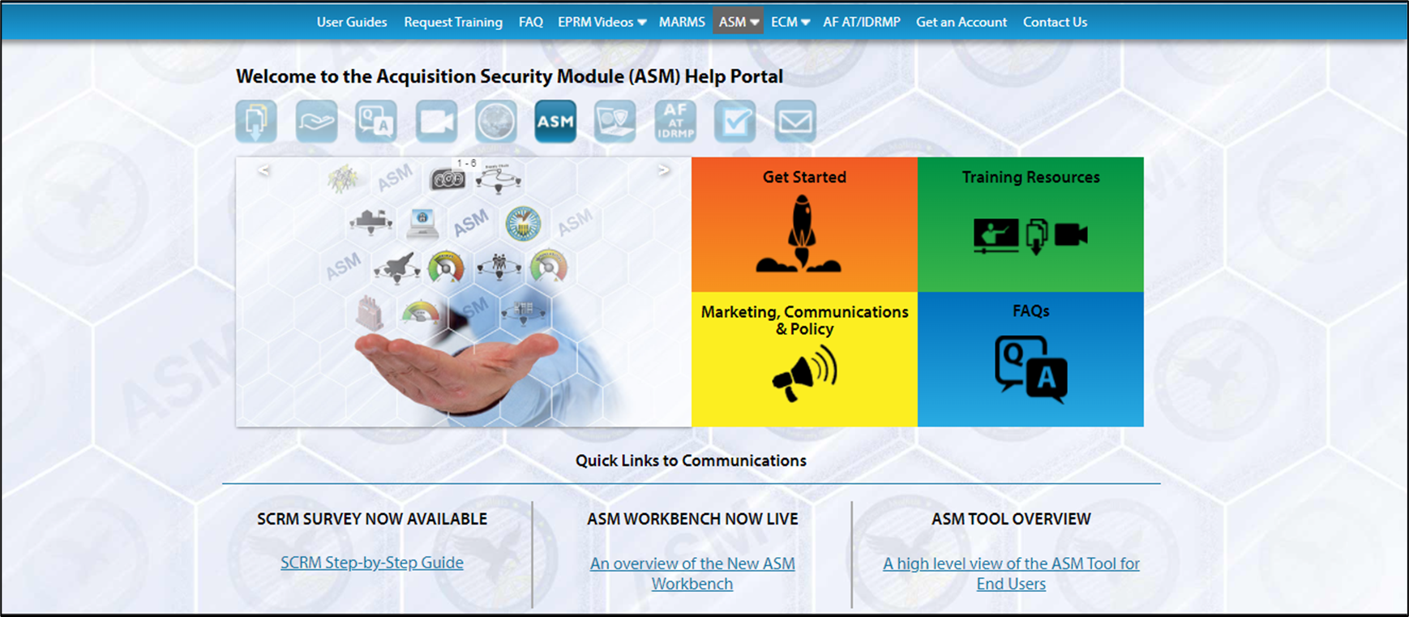
About ASM
Acquisition
Security
Module
https://www.milsuite.mil/video/watch/video/50297

Slide 7
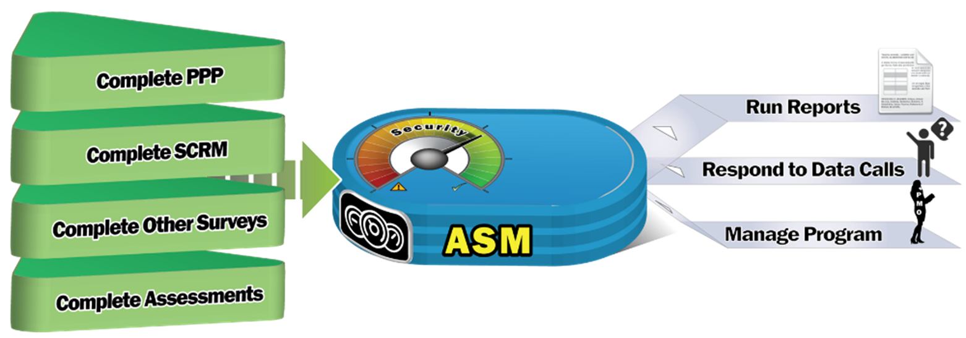
How ASM Works
REFRESHER CLASS FOCUS
Can Start NOW • Can hide work until ready to show • Hierarchy format which mirrors Acquisition.

Slide 8
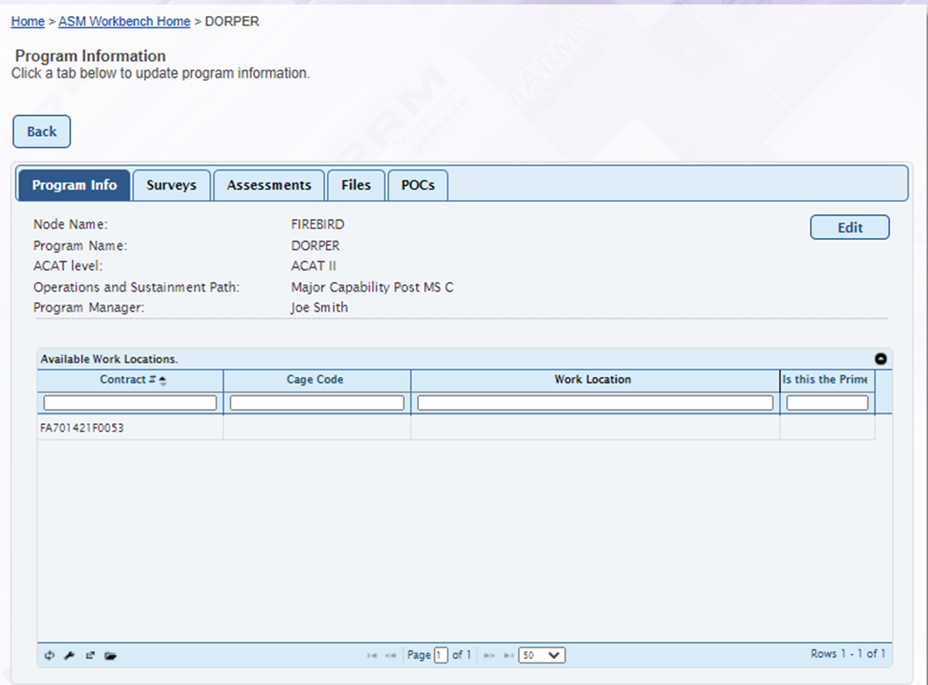
What’s New - ASM Workbench
Designed for focalized management of program
Automates assessment tasks
Eliminates dual entry for same questions
New file upload functionality
Enhanced Reporting and Analysis

Slide 9
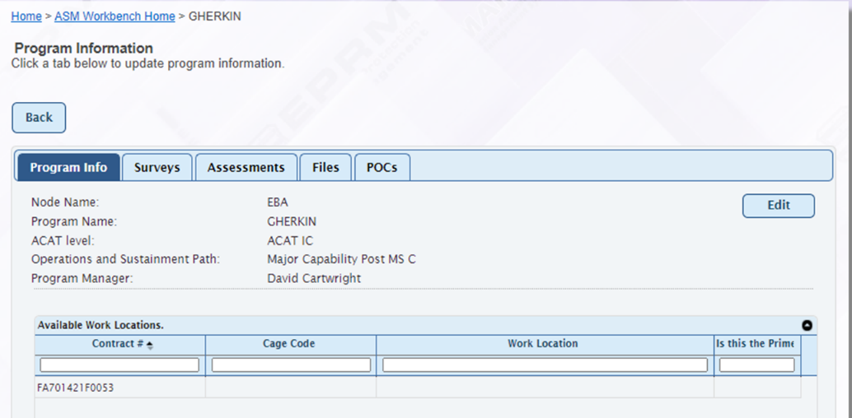
ASM Workbench
DORPER
CENTRALIZED PROGRAM MANAGEMENT
General program information is carried through all surveys, assessments and reports
Manage surveys; release work
Manage assessments; release work
All points of contact associated with program
All files associated with program
Contract information, including Prime and sub work locations
Additional tabs can be added such as WS Cyber and other “data call” questions.

Slide 10
Scenario
You are responsible for the PPP and SCRM for your Acquisition program.
The example shown is for the DORPER program but you can use your own program name when doing the exercises.
You should have received the following:
Login information
Example SCG file
Example OPSEC plan file
Example SCRM Survey file
The instructor will demonstrate the steps first, then you will do the exercise using the demo account.
At the end of the class, you will have a notional program with notional PPP and SCRM surveys and a Dashboard report example.

Slide 11
CREATING YOUR PROGRAM
INSTRUCTOR

Slide 12
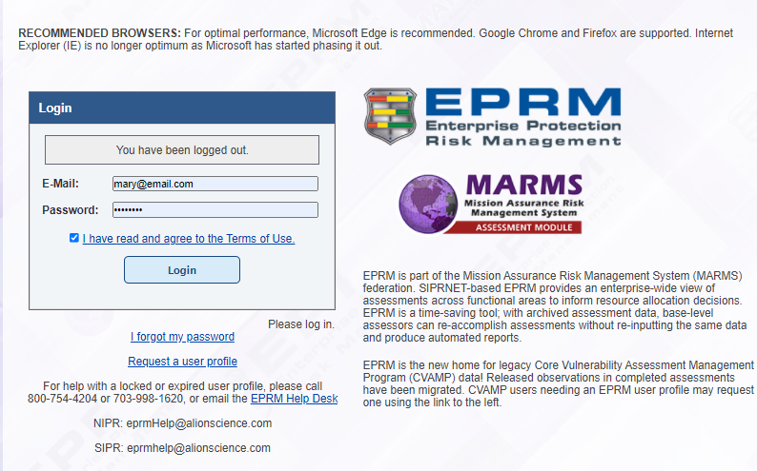
Login to ASM Demo
https://demo.countermeasures.com
Click on EPRM
Login: Your NIPR email
Password: password
Accept terms and conditions
Login to ASM.

Slide 13
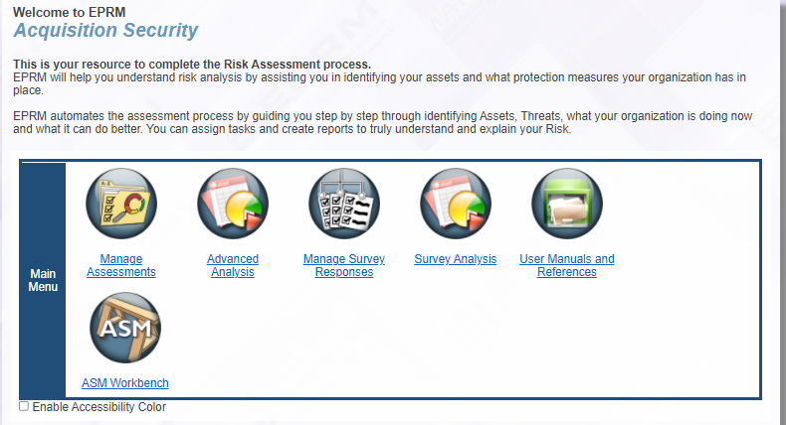
ASM Main Menu
Click on the ASM Workbench button.

Slide 14
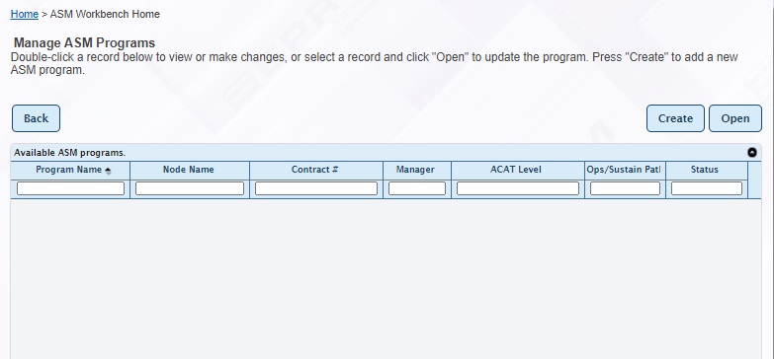
Add Your Program
To add your program, click on the Create button.
If you do not see your program, you need to add it.

Slide 15
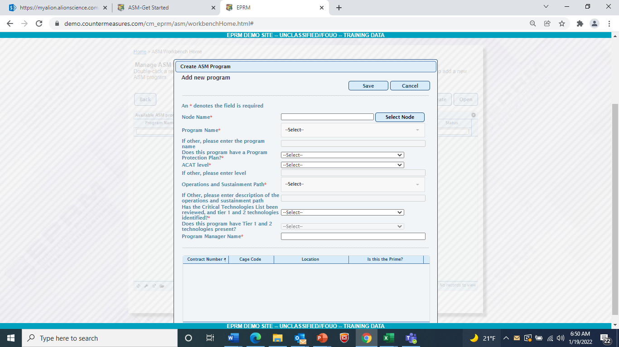
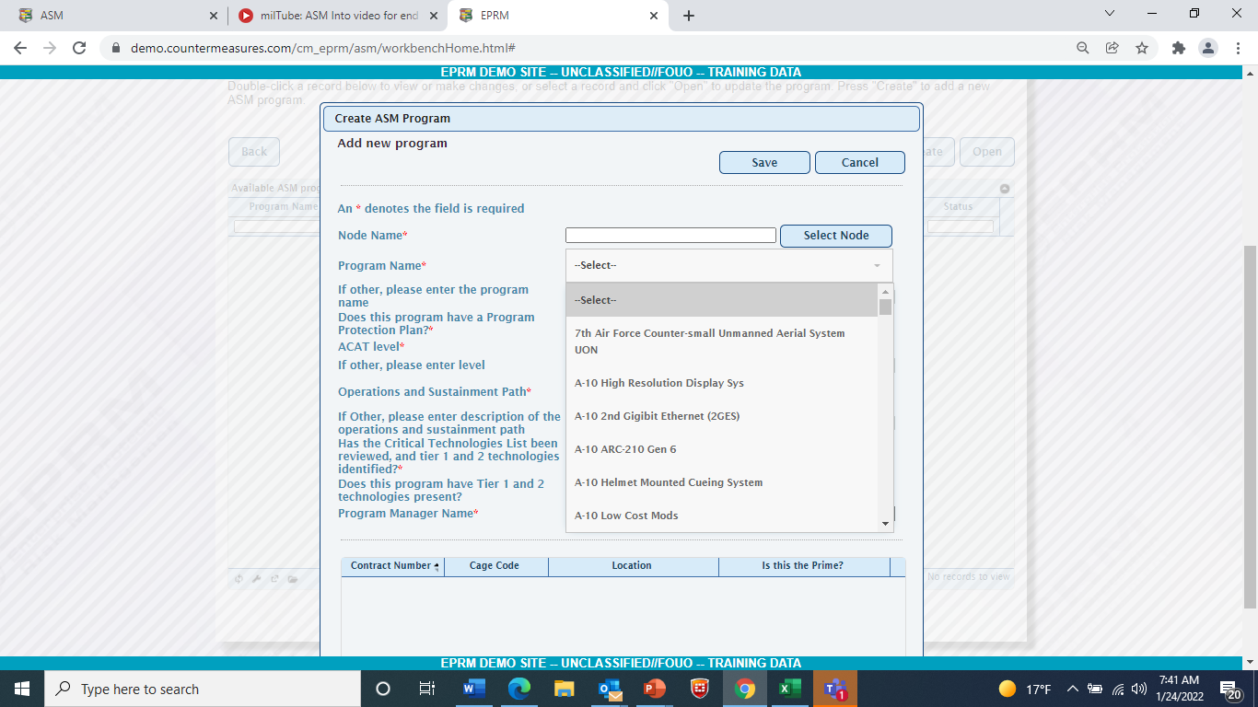
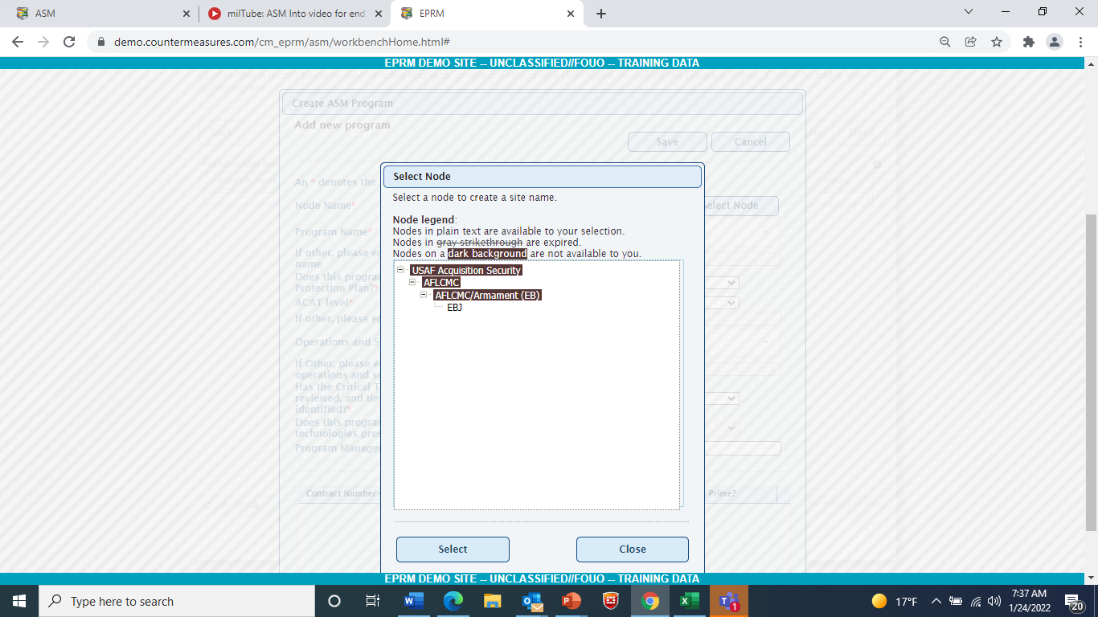
Add Your Program - Answer the Questions
Nodal Hierarchy is user based (others in other organizations do not see your work).
Programs listed
Question/answer/Save format
Click Save when done.
Program List
Nodal Hierarchy
Complete the information.

Slide 16
Exercise 1 – CREATE YOUR PROGRAM
PARTICIPANTS

Slide 17
Create your Program Steps
Go to https://demo.countermeasures.com
Click on EPRM button
Login: Your NIPR email
Password: password
Accept terms and conditions
Click on ASM Workbench icon
Click Create
Answer Questions
Click Save

Slide 18
BREAK
5 minutes

Slide 19
Create PPP
INSTRUCTOR

Slide 20
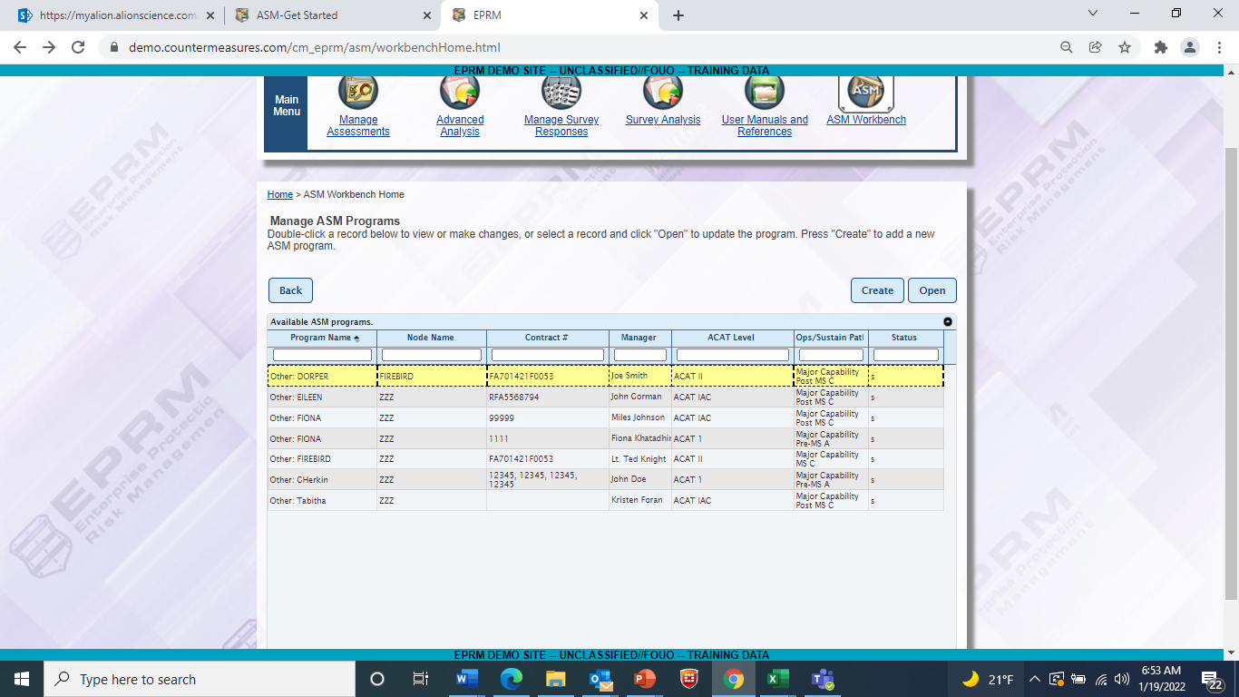
Create PPP
Double click on the program to open.

Slide 21
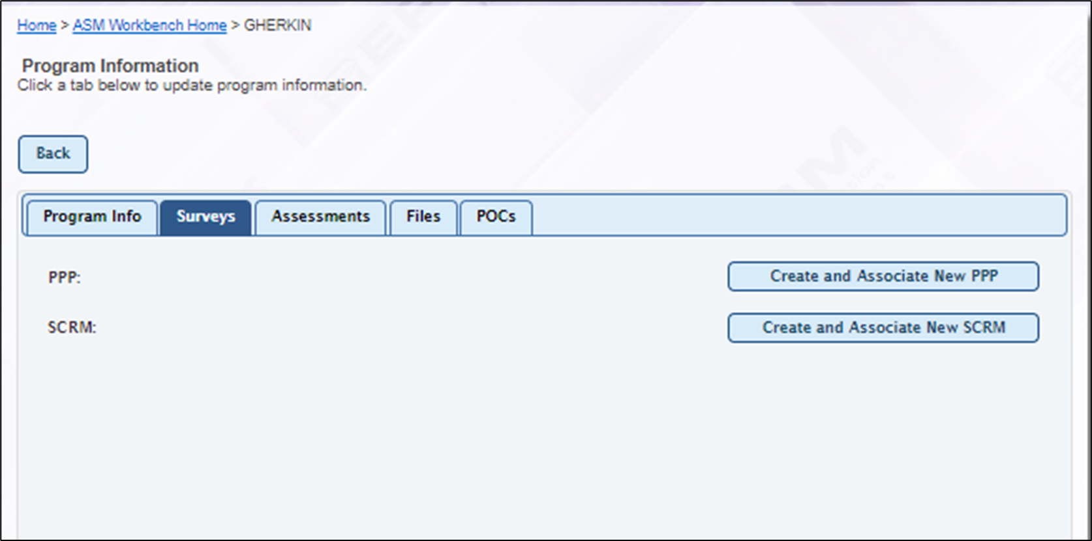
Create PPP, continued
Click on the Survey tab.

Slide 22
Create PPP, continued
Click on the Create and Associate New PPP.

Slide 23
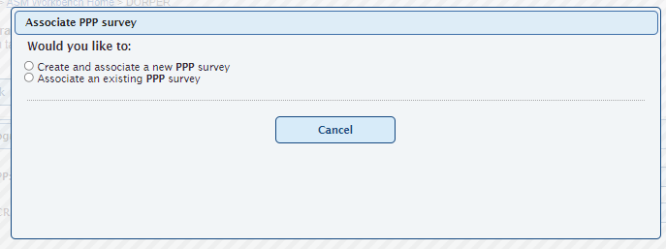
Create PPP, continued
Select Create and Associate New PPP.
Create when adding a new survey
Associate when you have previously completed a survey

Slide 24
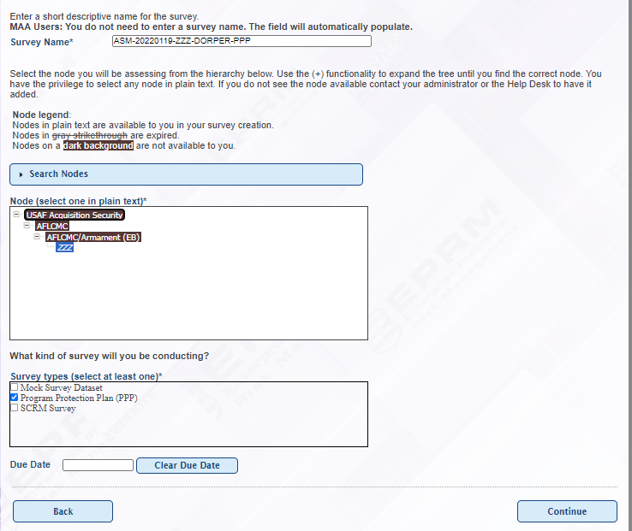
Create PPP, continued
Information from the workbench has been populated for you
Click Continue.

Slide 25
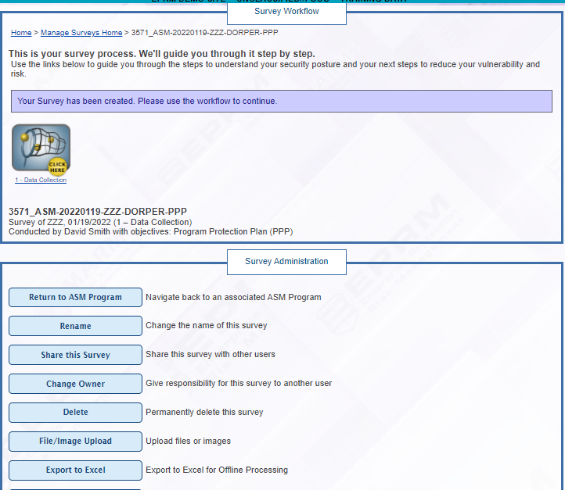
Create PPP, continued
Click on Data Collection icon to continue completing PPP
Later, you’ll use these options to manage your survey.

Slide 26
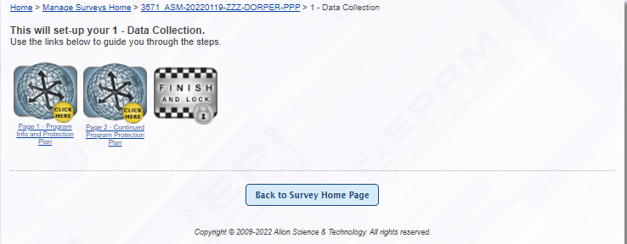
Create PPP, continued
Yellow “Click here” buttons show you where to click.
Finish and Lock icon aren’t available until work is complete.
Click on the Page 1 icon to continue completing the PPP.

Slide 27
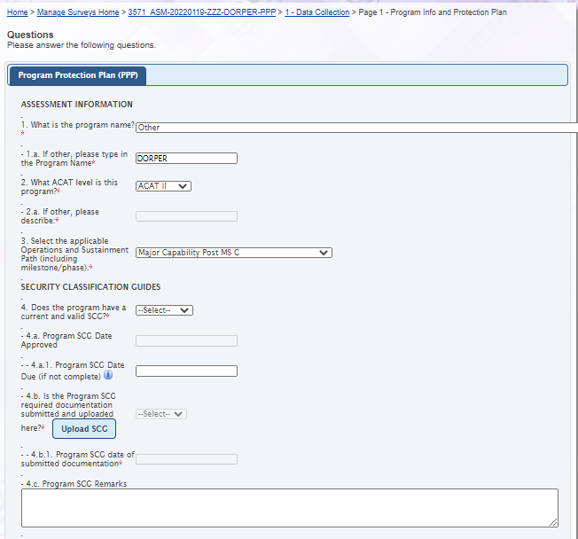
Create PPP, continued
Information from workbench is populated for you
Most of the questions are the same as the current MICT
File upload buttons enable you to upload information applicable to the question.
Red asterisk (*) indicates the question is required.
Complete remaining questions
Upload Sample SCG
Click Continue to go to next page
Complete the questions (notional data).
Answer ‘Yes’ to SCG questions and Example SCG Upload File.

Slide 28
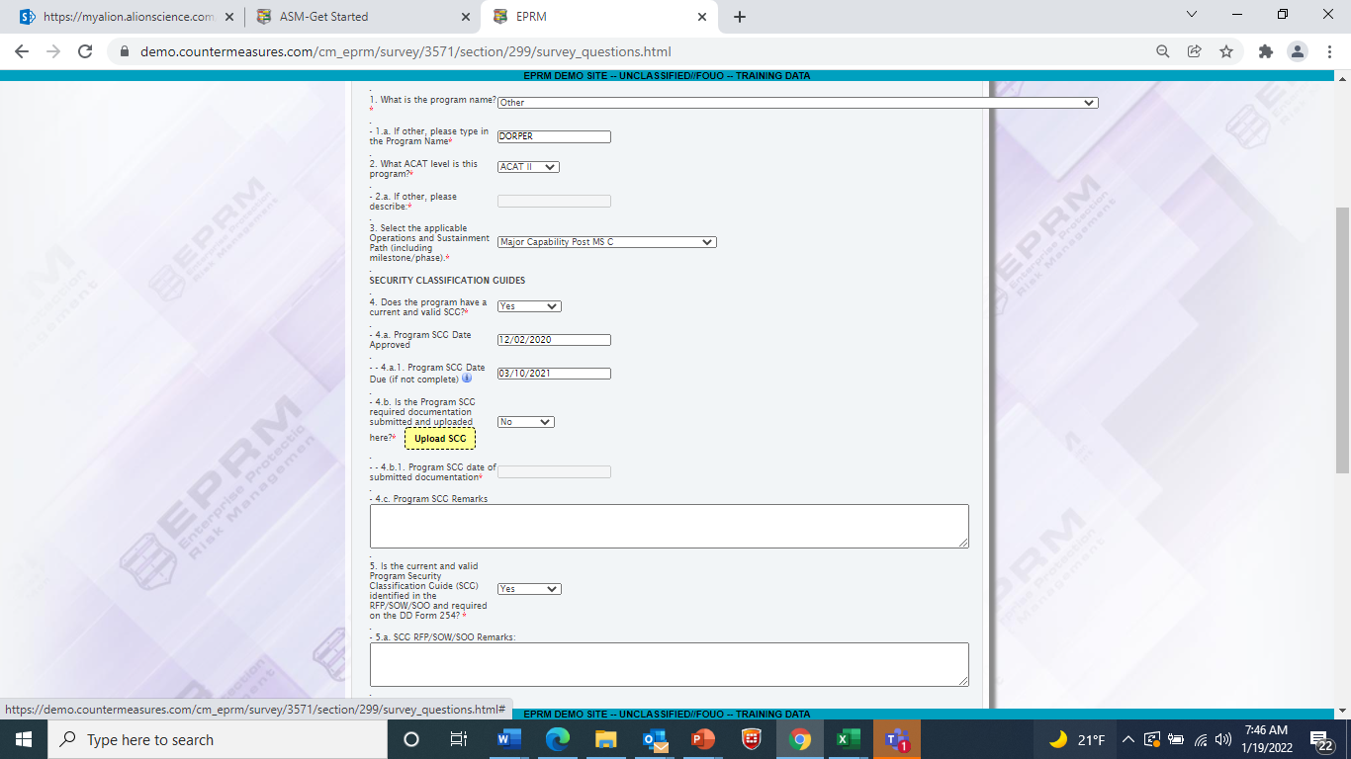
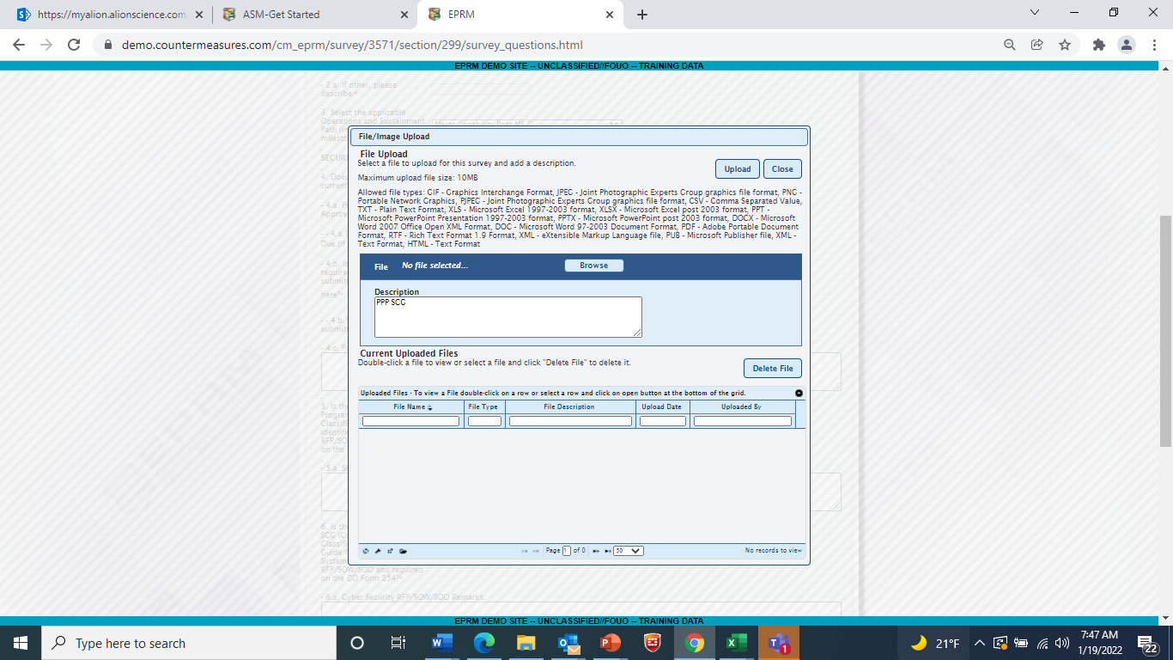
Create PPP, continued
Browse for the Example SCG file.
Click on the Upload SCG button.

Slide 29
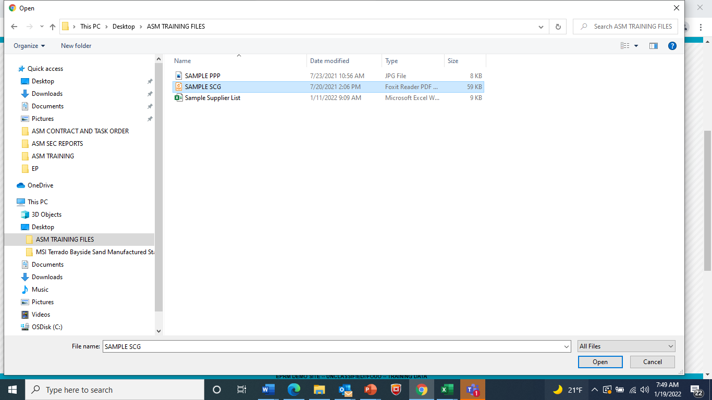
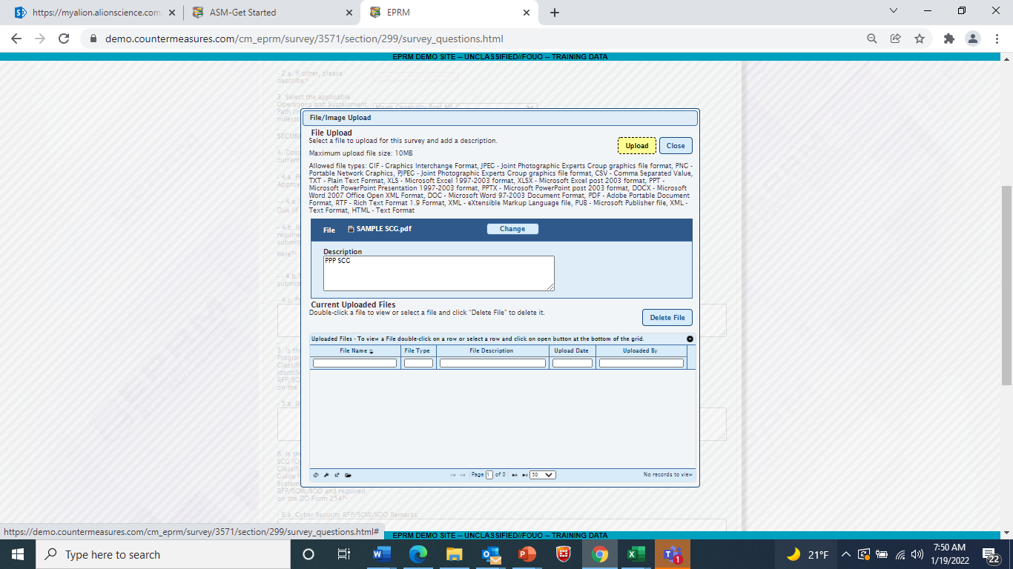
Create PPP, continued
Click on the Upload button.

Slide 30
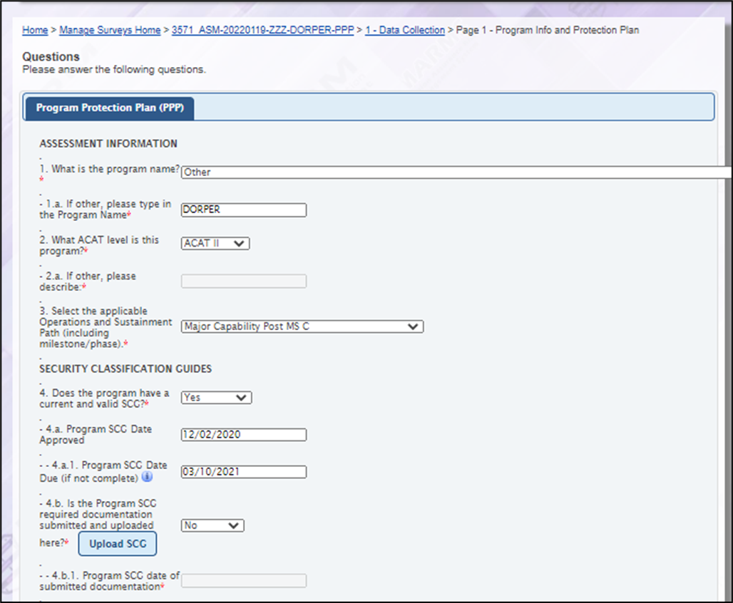
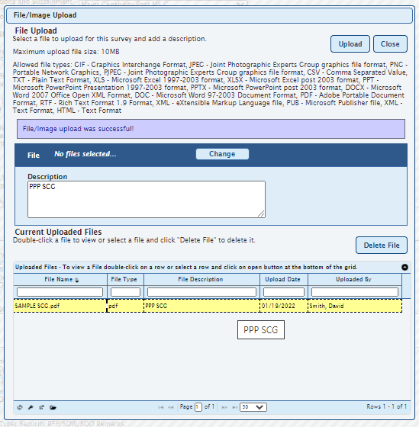
Create PPP, continued
Click on the Close button to return to survey.

Slide 31
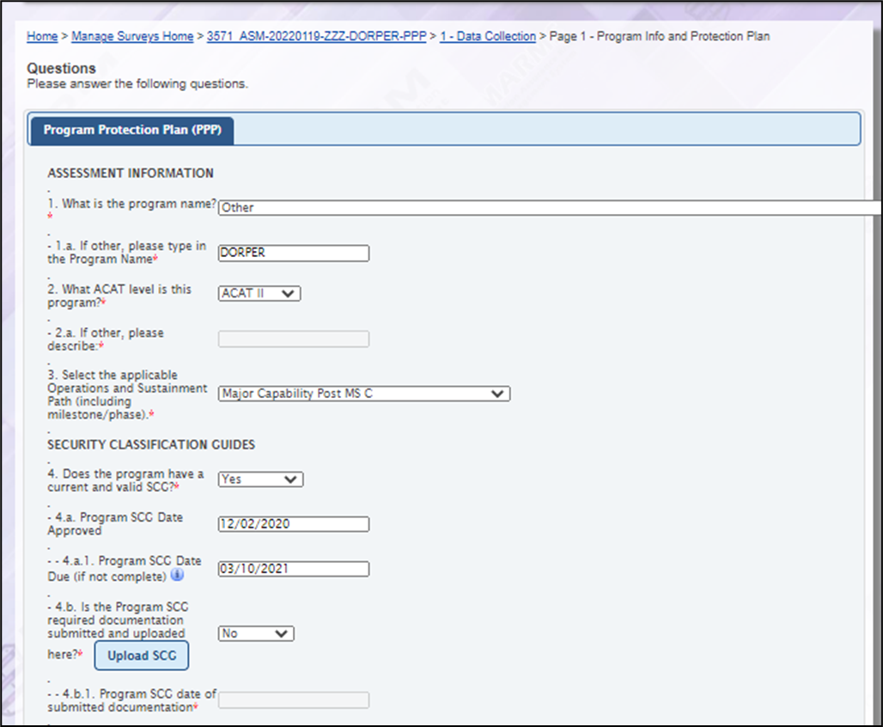
Create PPP, continued
Complete the remaining Survey.

Slide 32
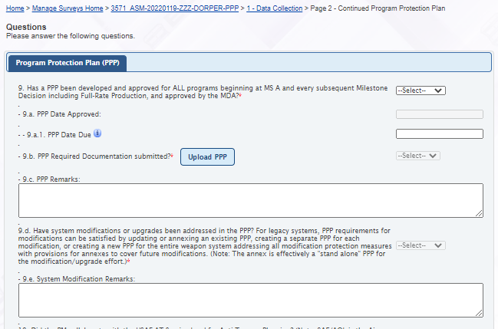
Create PPP, continued
Complete Page 2
Click Continue

Slide 33
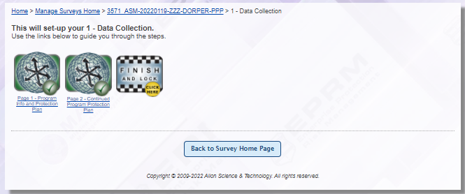
Create PPP, continued
Click on Finish and Lock.

Slide 34
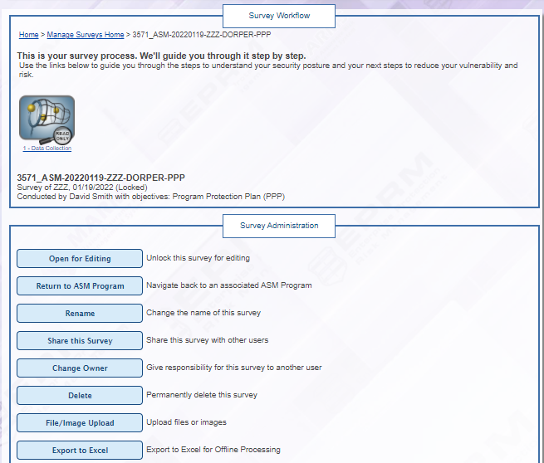
Create PPP, continued
Click on Return to ASM Program.

Slide 35
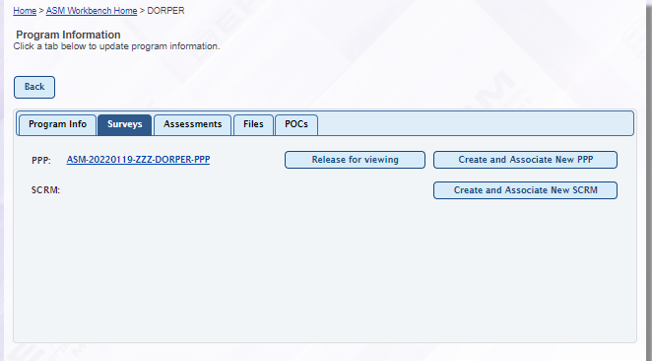
Create PPP, continued
PPP is complete and can only be seen by you until you release it.
It will not be available for review or reports until you are ready.
You can share to another ASM user
Open the survey by clicking on the hyperlink to survey
Release for viewing button is a toggle button. When it says Release for viewing = hidden
When it says Unrelease for viewing = Not hidden; available to higher ups and reports

Slide 36
EXERCISE 2- Add YOUR PPP
Participants

Slide 37
Add Your PPP Steps
Logged into ASM
Click on Workbench
Double click on your program to open
Click on Survey tab
Click on Create and Associate PPP
Select Create and Associate New
PPP
Click on Data collection
Answer the questions
Load Example SCG file
Complete full survey
Click on Finish and Lock
Click on Return to ASM Program
Click on Survey Tab
Click Release for Viewing Button
These steps may not be necessary if you are already in ASM

Slide 38
FILE TAB, ADDING A POC, SHARE TO ANOTHER USER
INSTRUCTOR

Slide 39
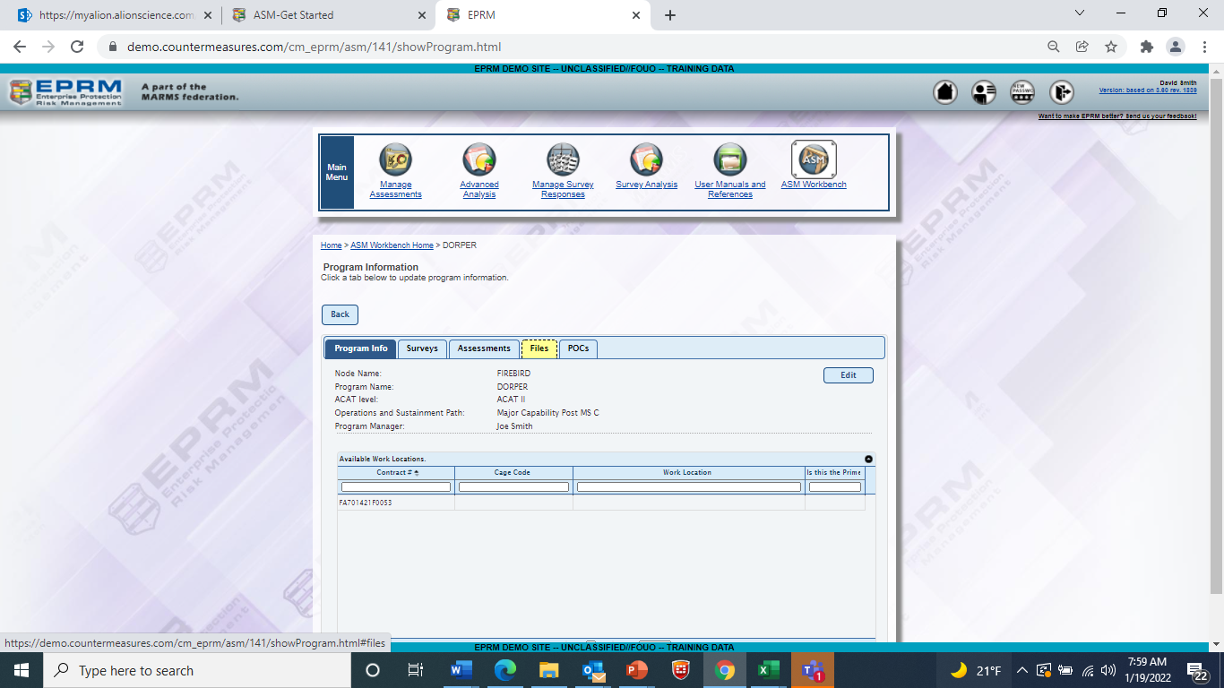
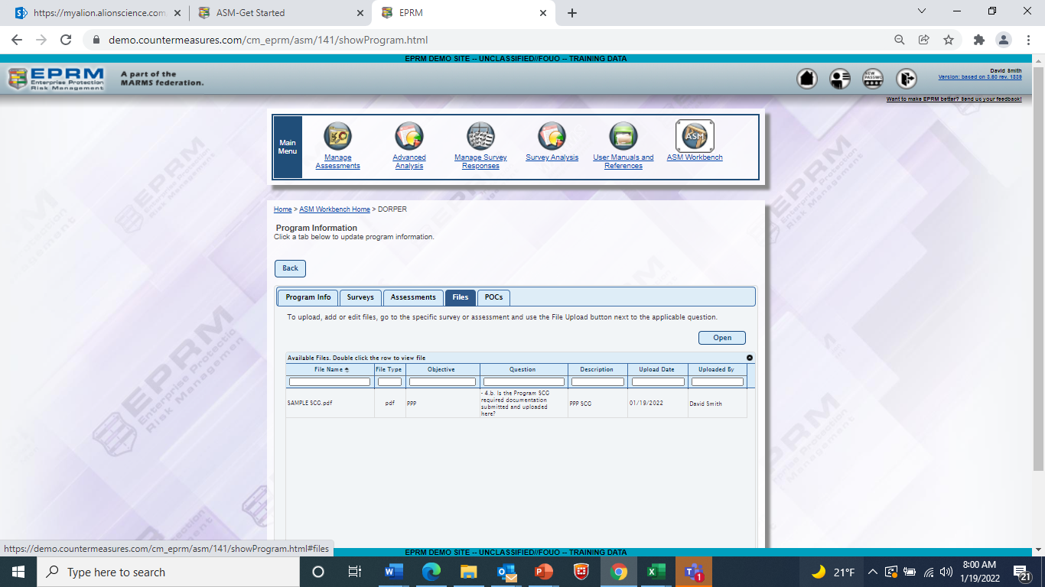
File Tab
Click on File tab.
Double click on File to open.

Slide 40
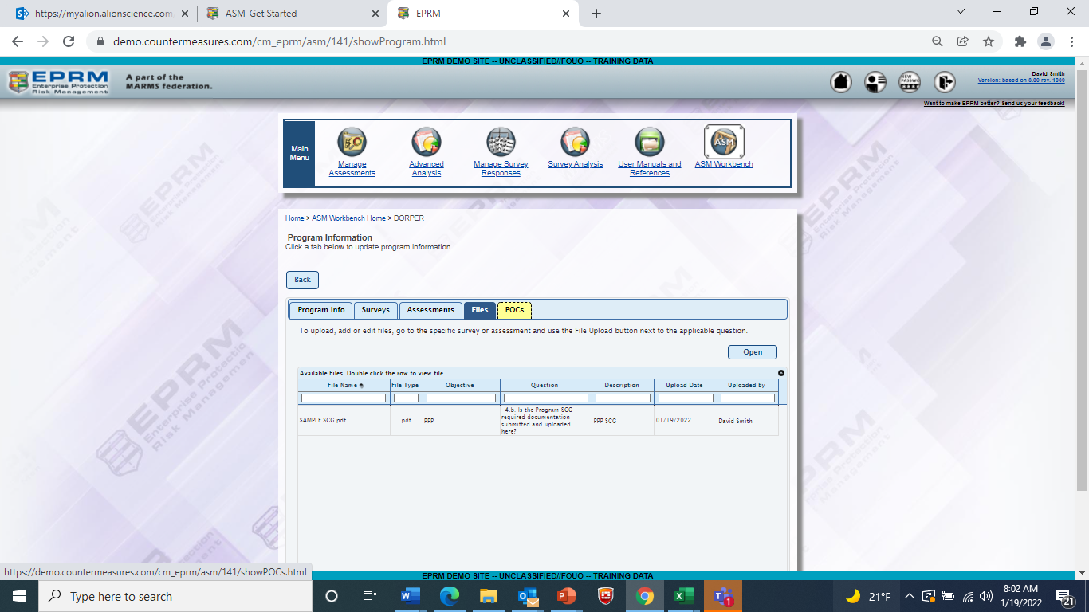
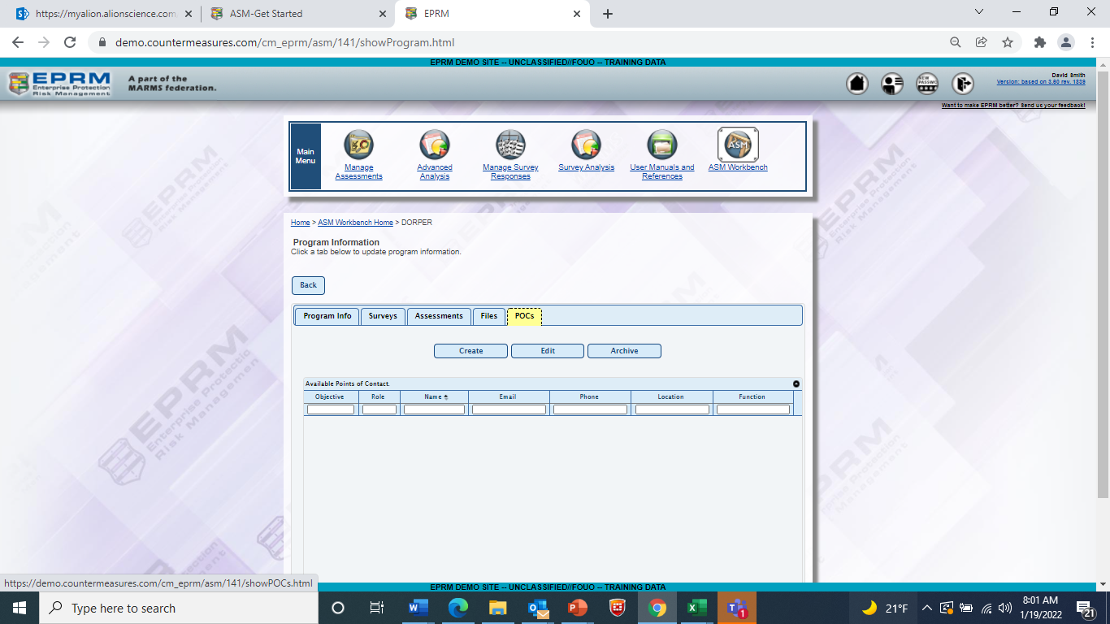
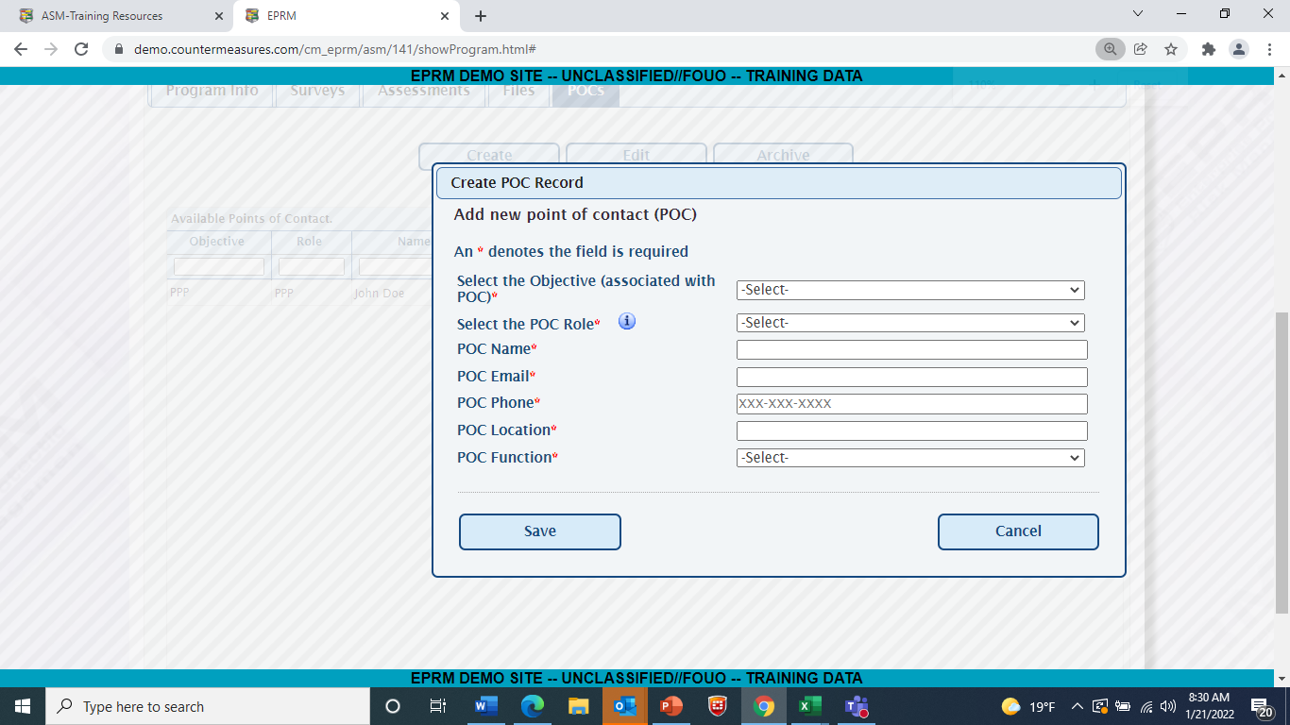
POC Tab
Click on POC tab.
Click Create.
Complete Information.
Click on Save.

Slide 41
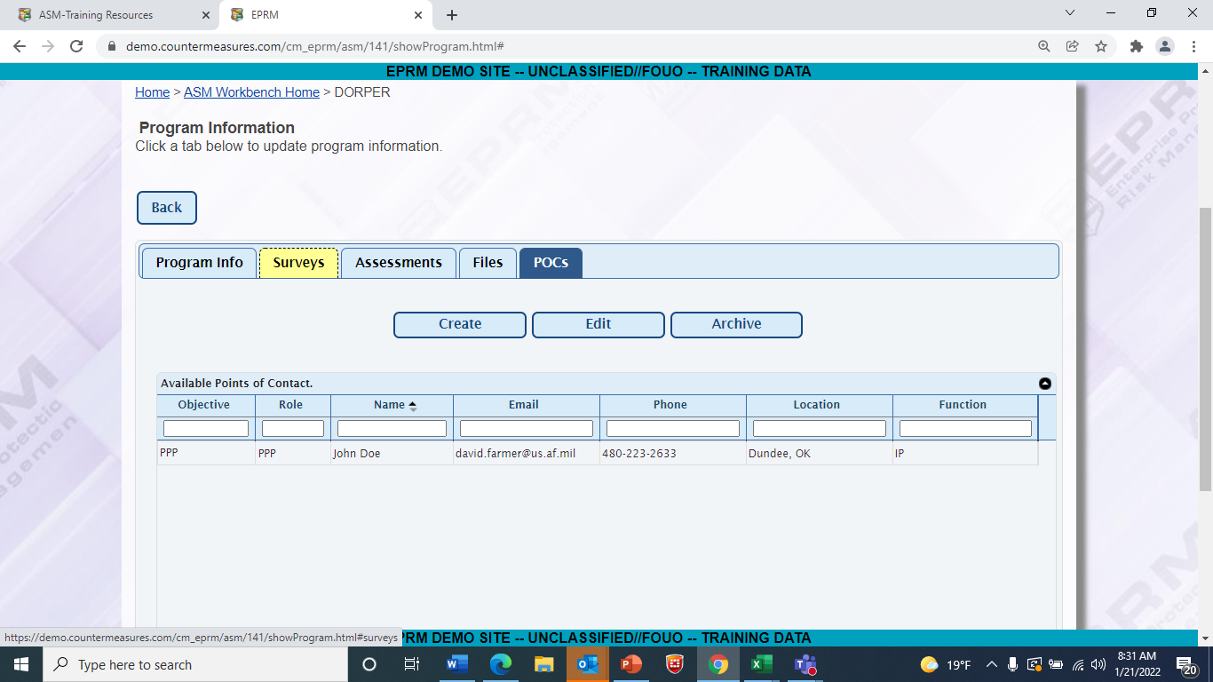
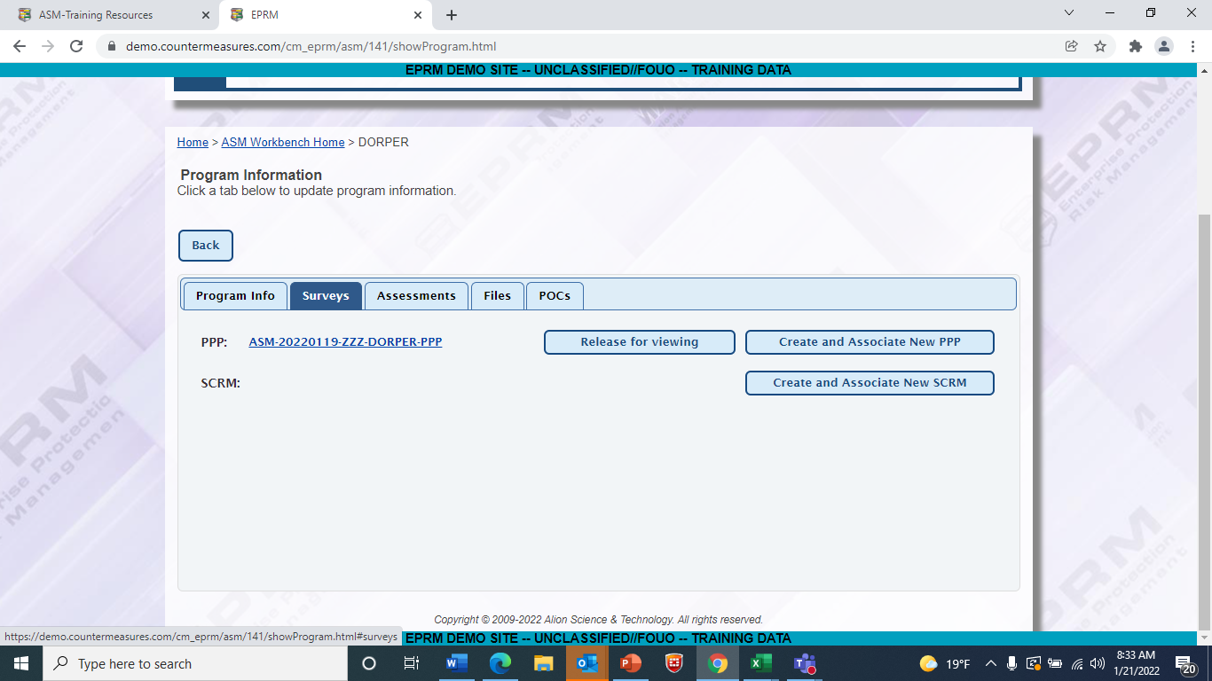
Share a Survey
1. Click on Survey tab.
2. Click on hyperlink of survey to share.

Slide 42
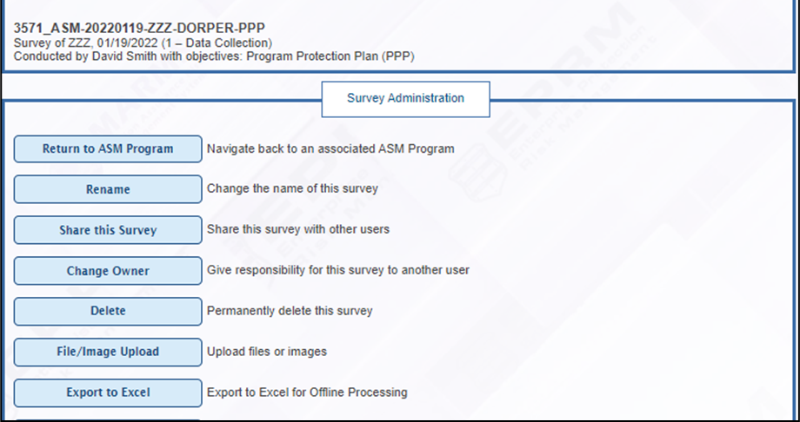
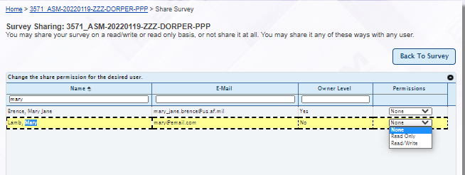
Share a Survey
1. Click on Share this Survey.
4. Click on Back to Survey to return to Survey.
2. Select person to share with.
3. Select permissions.

Slide 43

Return to ASM Program
Click on Return to ASM Program to return to Workbench.

Slide 44
EXERCISE 3 - View FILE, ADD A POC, SHARE TO CATHY SUMERACKI, (READ ONLY)
PARTICIPANTS

Slide 45
View a File
View File
Click on File tab
Double click on file to view
Close File
Add a POC
Click on POC tab
Click Create
Complete information
Click Save
Share a Survey
Click on Survey tab
Click on PPP survey hyperlink
Click on Share
Share to Cathy Sumeracki
Select Read only
Click on Return ASM Program

Slide 46
BREAK
Congratulations- You have successfully added your program, added a PPP (including file upload), viewed a file, added a POC and shared a survey!

Slide 47
UPDATE A PPP OR SCRM
INSTRUCTOR

Slide 48

Update Survey
Click on survey hyperlink.
Make sure this reads “Release for Viewing”.

Slide 49
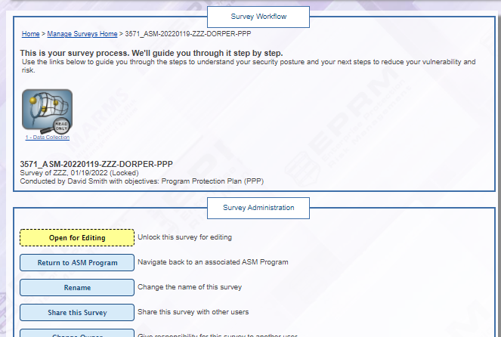
Update Survey, continued
Click on Open for Editing.

Slide 50
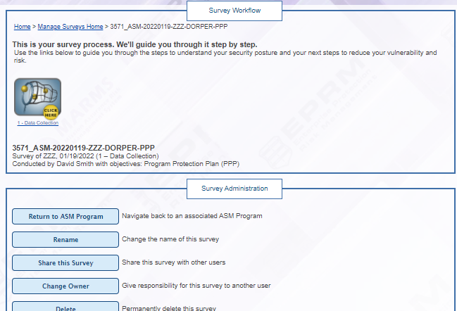
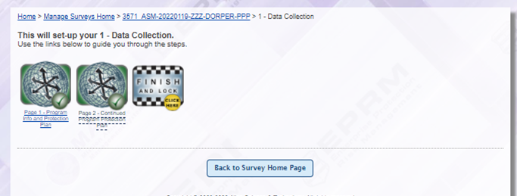
Update Survey, continued
Click on Data Collection.
Open page(s) for editing.

Slide 51
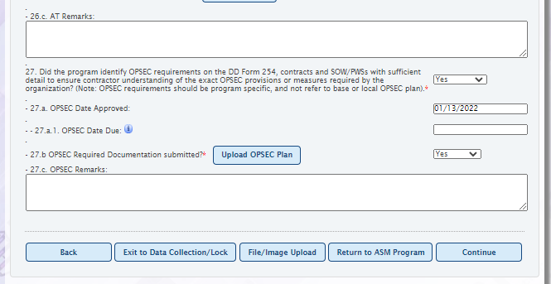
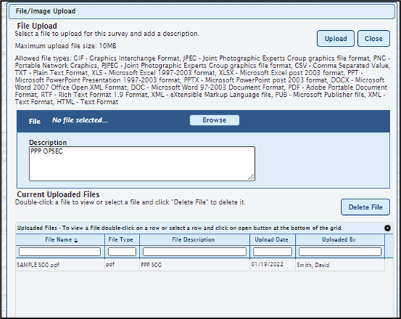
Update Survey, continued
Make edits.
In this example, we will upload a file.
Change the answer to 27.b to “Yes”
Click on the Upload OPSEC Plan button.
Click Browse to locate and double click the file to upload.

Slide 52
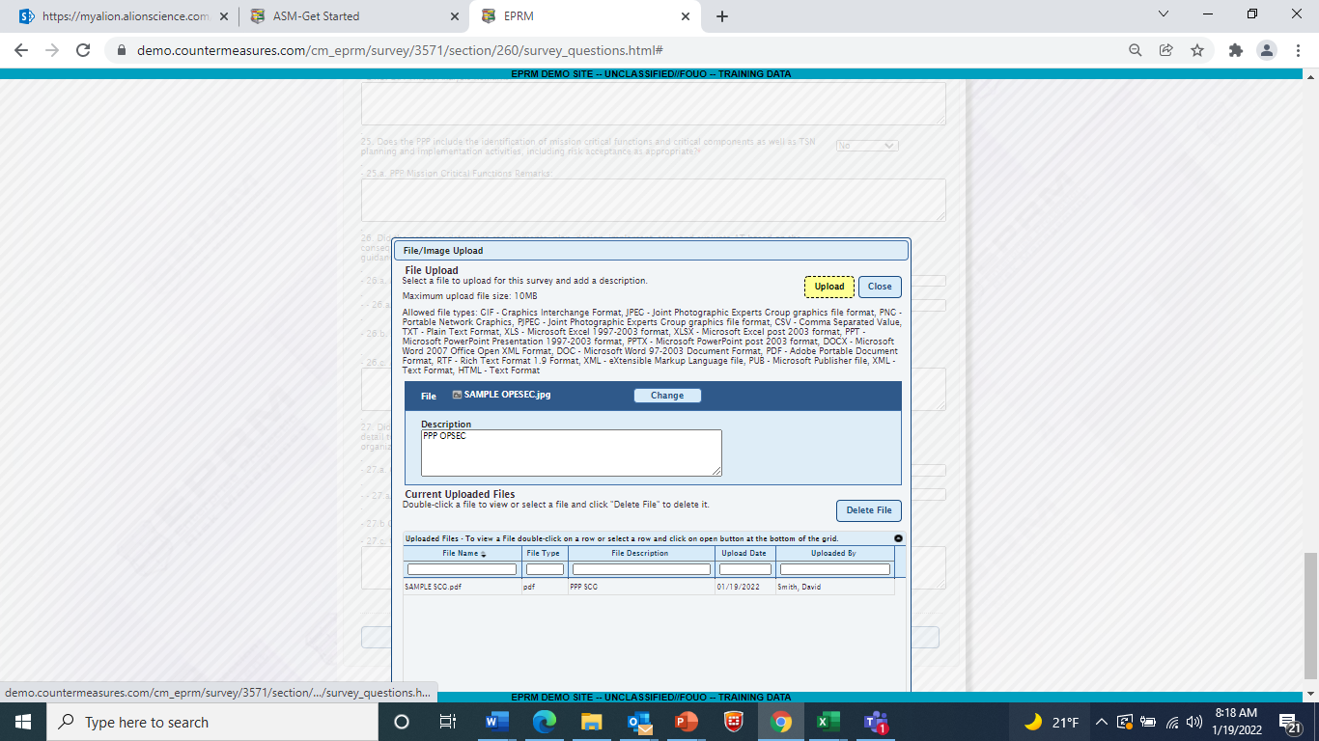
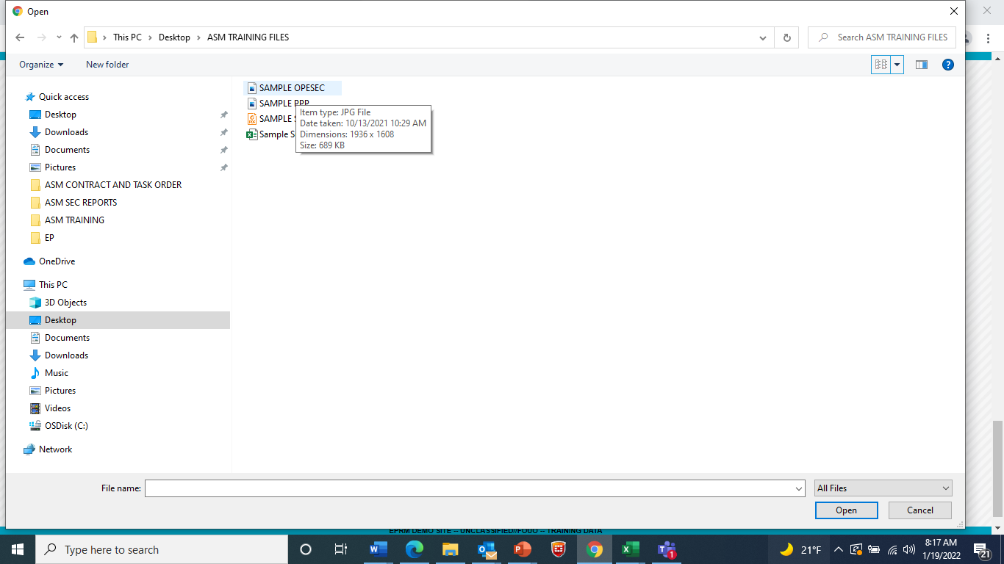
Update Survey, continued
Click Upload to upload the file then Click close to return to survey.
Find the file.

Slide 53
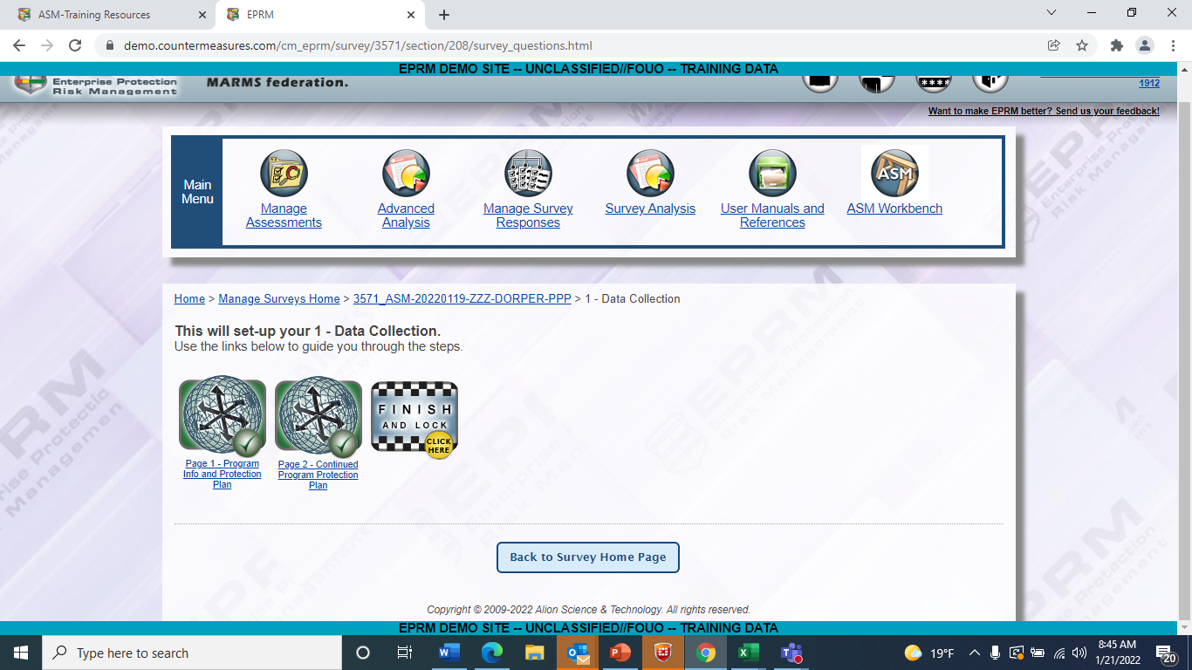
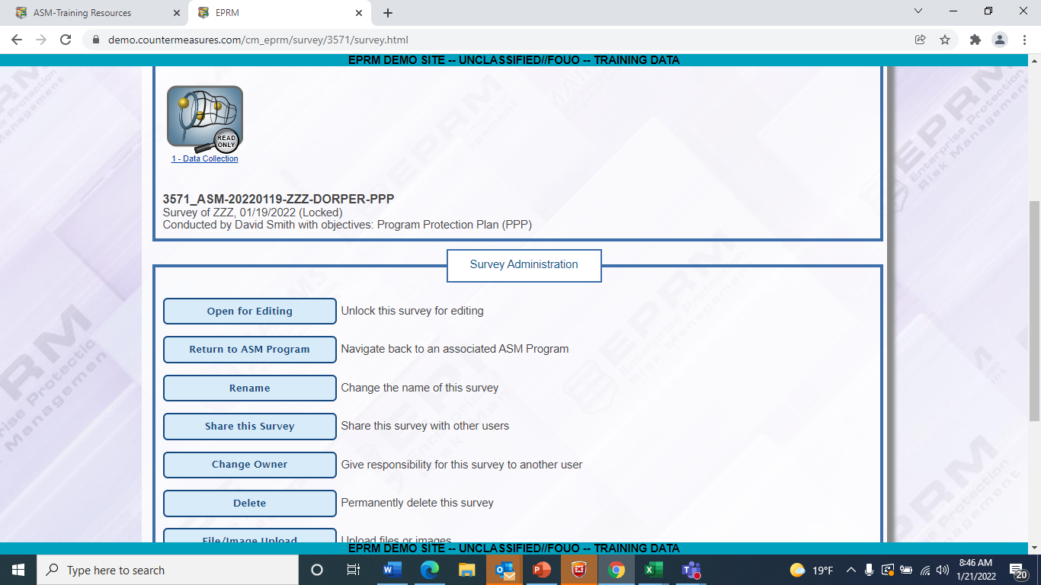
Update Survey, continued
Click on Finish and Lock.
Click on Return to ASM Program.

Slide 54
EXERCISE 4 – update ppp/upload opsec plan
Participants

Slide 55
NIPR to SIPR Process
When you want to work on your program
but do not have access to SIPR

Slide 56
NIPR to SIPR Process
NIPR
SIPR
Go to ASM Help page.
http://eprmhelp.countermeasures.com/asm.html
Go to Training and Resources.
Go to Downloads area.
Here are downloadable files which allow you to work on your program via Excel then upload the work later.
This includes surveys, assessments and statements of work.
Download SCRM questions.
Answer questions.
Save file.
Login into ASM and go to ASM Workbench
Double click on program to open it
Click on Survey tab
Click on Create and Associate SCRM survey
Select create and associate a new SCRM survey
Click continue on survey creation page
Click Upload Responses on Survey home page administrative menu
Click on Browse to locate the file
Click on Upload button
Click on Back button to return to Survey
Finish and Lock
Click on Return to ASM Program to release (if ready)

Slide 57
Task 1: Use NIPR to Complete Tasks
Go to ASM Help portal.
http://eprmhelp.countermeasures.com/asm.html
Go to Training and Resources.
Download SCRM questions.
Answer questions in Excel.
Save file.

Slide 58
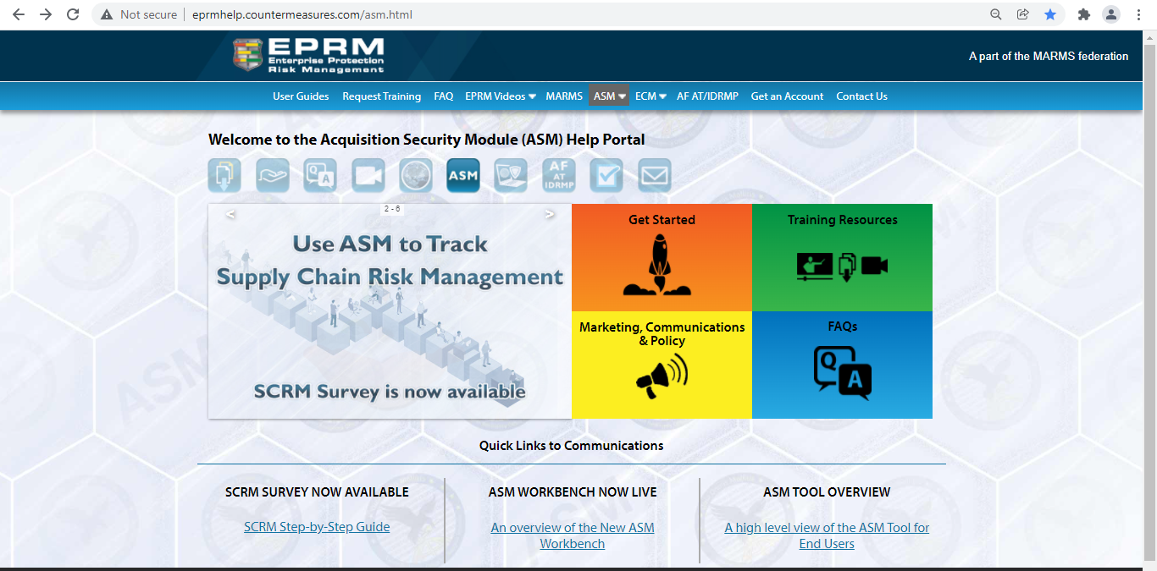
NIPR to SIPR Process (NIPR)
Go to ASM Help Page.
Go to Training Resources.
eprmhelp.countermeasures.com/asm-html

Slide 59
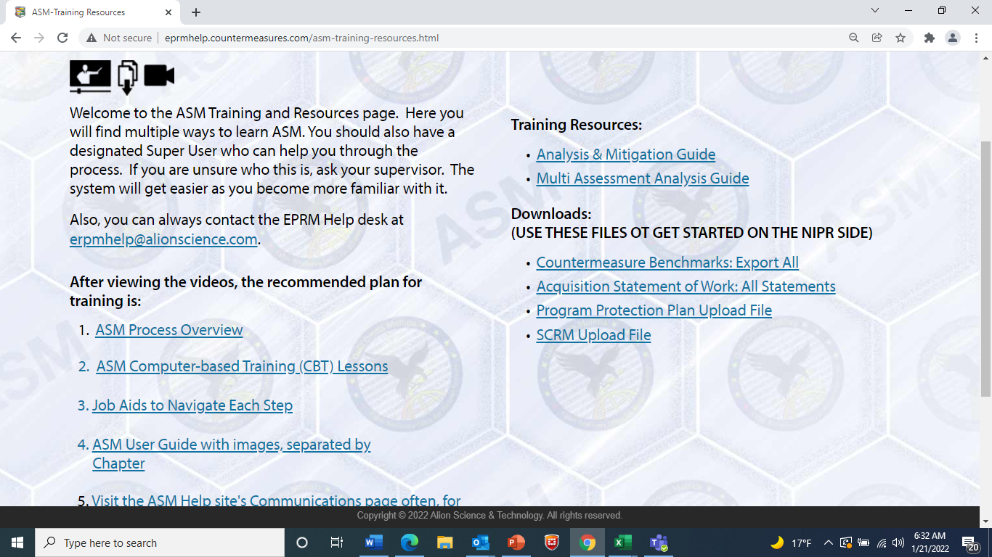
Download the upload file.
In this example, we will use the SCRM file.

Slide 60
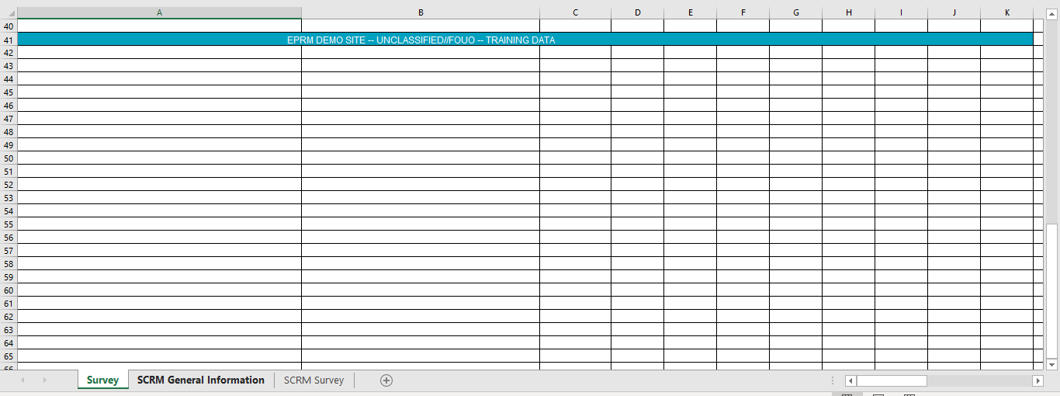
NIPR to SIPR Process (NIPR)
Note the tabs correspond with the pages of the ASM survey. Click on the SCRM Survey tab.

Slide 61

NIPR to SIPR Process (NIPR)
Drop down answers in the Excel file are the same as in the survey.
Complete the questions.

Slide 62

NIPR to SIPR Process (NIPR)
Save the file.

Slide 63

NIPR to SIPR Process (SIPR)
Log in to ASM on SIPR.
Files can be on scanned disk or as a DOTS delivered file.
Be sure and follow all government guidelines when using NIPR to SIPR file transfer.

Slide 64

Click on ASM Workbench
Click on the ASM Workbench icon.

Slide 65

NIPR to SIPR Process (SIPR)
Double click on your program to open it.

Slide 66

NIPR to SIPR Process (SIPR)
Go to the Surveys tab.

Slide 67


NIPR to SIPR Process (SIPR)
1. Click on Create and Associate New SCRM.
2. Select Create and Associate new SCRM survey.
3. Click Continue.

Slide 68

NIPR to SIPR Process (SIPR)
Click Continue on the survey creation page since this has been populated for you.

Slide 69

NIPR to SIPR Process (SIPR)
Click on the Upload Responses button.

Slide 70

NIPR to SIPR Process (SIPR)
Click on the Browse button.

Slide 71

NIPR to SIPR Process (SIPR)
Double click on the file to upload or select it and click on Open.

Slide 72

NIPR to SIPR Process (SIPR)
Click on the Upload button.
You will see file name here.

Slide 73

NIPR to SIPR Process (SIPR)
Click on the Back button to return to survey home page.
Banner indicates successful upload.
Questions answered show here.

Slide 74


NIPR to SIPR Process (SIPR)
Yellow “Click here” indicates there is a required question which was not answered in Excel. Click on it.
Yellow “Click here” indicates there is a required question which was not answered on page 2 of the survey. Click on it.

Slide 75

NIPR to SIPR Process (SIPR)
Answer the required questions.

Slide 76


NIPR to SIPR Process (SIPR)
Click on Finish and Lock.
Click on Return to ASM Program.

Slide 77

Survey Tab
Use the toggle buttons to release or unrelease work for viewing and reports.

Slide 78

Toggle Buttons Until Both Released
When the buttons read “Unrelease for Viewing”, it means it is available for reports and viewing.

Slide 79
EXERCISE 5 – ADD A SCRM USING NIPR PROCESS (USE EXAMPLE FILE)
Participants

Slide 80
NIPR to SIPR Process
NIPR
SIPR
Go to ASM Help page.
http://eprmhelp.countermeasures.com/asm.html
Go to Training and Resources.
Go to Downloads area.
Here are downloadable files which allow you to work on your program via Excel then upload the work later.
This includes surveys, assessments and statements of work.
Download SCRM questions.
Answer questions.
Save file.
Login into ASM and go to ASM Workbench
Double click on program to open it
Click on Survey tab
Click on Create and Associate SCRM survey
Select create and associate a new SCRM survey
Click continue on survey creation page
Click Upload Responses on Survey home page administrative menu
Click on Browse to locate the file
Click on Upload button
Click on Back button to return to Survey
Finish and Lock
Click on Return to ASM Program to release (if ready)

Slide 81
BREAK
Congratulations - You have now successfully executed the NIPR to SIPR process!

Slide 82
REPORT AND ANALYSIS
Instructor

Slide 83

Reports Overview
Survey Analysis for PPP, SCRM and other Surveys
Click on Survey Analysis icon.

Slide 84

Survey Reports and Analysis
Select the objective.
In this example, we are using SCRM Survey.
Released surveys available for reports show here.

Slide 85


Survey Reports and Analysis
Select the survey(s) to include in your reports or analysis.
Click on the Continue to Analysis button.

Slide 86

Survey Reports and Analysis
Select the report.
In this example, we are selecting the SCRM Dashboard report.

Slide 87

Survey Reports and Analysis

Slide 88

SCRM Dashboard Report
This shows how categories of questions were answered..
This shows surveys included.
SCRM question are weighted so some questions are worth more than others. The gauge shows the overall program score based on how the questions were answered.

Slide 89

Compliance Report
Shows how each question was answered
Can be done using multiple surveys to show how programs compare (permissions required/based on hierarchy)
This reports shows how each PMO answered each question.

Slide 90
EXERCISE 6 – Run A PPP DASHBOARD REPORT
Participants

Slide 91
Dashboard Report Steps
Click on Survey Analysis
Select PPP as the objective
Select the PPP program
Click Continue
Click on Generate PPP Dashboard Report
Click on PPP Compliance Report

Slide 92
Reports – How They Work
Reports
Click on reports and analysis button or icon
For Surveys – Click on Survey Analysis
For Assessments – Click on Advanced Analysis
Select criteria for surveys or assessments to include in report
Select Report to run
Analysis
Click on applicable analysis icon
For Surveys – Click on Survey Analysis
For Assessments – Click on Advanced Analysis
Click on Survey Analysis
Select surveys to include in report
Select specific question for survey or assessment OR
Generate complete data file

Slide 93
Recommended ASM Reports
Surveys
PPP Dashboard Report
PPP Compliance Report
SCRM Dashboard Report
SCRM Compliance Report
Assessments
ASM Executive Summary Report
ASM Dashboard Report

Slide 94


Analysis
Select multiple surveys (permission/hierarchy based
Click Continue to Analysis

Slide 95

Select Specific Question
This shows:
2 programs have SCG scheduled to be completed
28 programs have their SCG
3 programs do not have SCGs

Slide 96

Survey Analysis - Detail Tab
The Detail tab shows how each survey answered the question.

Slide 97
Assessments
Instructor

Slide 98
Assessment – High Level Overview
Can Start NOW • Can hide work until ready to show • Hierarchy format which mirrors Acquisition

Slide 99

Assessment Overview
PPP and SCRM Surveys complete
Complete Baseline and PMO Assessments
Series of assessments to show risk over time • Automated in ASM •
Process is the essentially the same for each assessment

Slide 100

Assessments
Existing Programs can add their Baseline and PMO Assessments NOW

Slide 101

Click on Assessments
Click on the Assessments tab.

Slide 102

Click on Create
Click on the Create button.

Slide 103

Answer Information
Answer the questions.
Save.

Slide 104

Click Continue
Click Continue on the assessment creation page since this information has been populated for you.

Slide 105

Assessments
Complete the information
Click Continue and follow the onscreen instructions
Answer the questions and click Next Section/Tab to complete assessment.
Follow the onscreen instructions for each page.

Slide 106

ASM Takes you Through Step by Step
Questions on your program
Pre-scored assets. Select the assets in your program.
Pre-scored threats and vulnerabilities. No work required.
Recommended countermeasures based on applicable policy. Also includes NIST, NISPOM and traditional security.

Slide 107
Summary
Congratulations
You now have the skills to:
Add your PPP and SCRM Surveys
Add Program
Upload Files
Use NIPR to SIPR Process
Use the ASM Help Page for additional training
Start Your Baseline assessment
Run Survey Reports

Slide 108
Tips for Success
Explore, Explore, Explore
Get your PPP and SCRM on SIPR
Start the Assessment process
Baseline
PMO
When in doubt – REACH OUT
EPRM Help Desk
Cathy directly 480-223-2633

Slide 109
Additional Resources
ASM Help Page
Training and Resources
Step by step job aids
Detailed Instructions (user guide)
Computer based training
Lesson 1 – Overview
Lesson 2 – Adding PPP and SCRM
Lesson 11 – Reports
ERPM Help Desk – eprmhelp@alionscience.com
User References and Materials link on SIPR

Slide 110
Training Feedback Link
Your feedback is important. Please use the following link to provide feedback:
https://tsd.huntingtoningalls.com/countermeasures/training-feedback/

